Slide 1
Secure Data Group Sharing and Conditional Dissemination with Multi-Owner in Cloud Computing

Slide 2
ABSTRACT
With the fast development of cloud services, huge volume of data is shared via cloud computing. Even though cryptographic techniques have been utilized to provide data confidentiality in cloud computing . Data Owner encrypts & uploads the file into the cloud and tags co-owner of the file. Data Co-Owners append access policies and generate renewed ciphertext. Data Disseminator gives re-encryption key to desseminate the data if he satisfies enough access policies. Data Accessor decrypt the data by giving his private key. The security analysis scheme is efficient for secure data sharing with multi-owner in cloud computing. In this project we use symmetric key encryption algorithm to encrypt the data before storing into the cloud server.

Slide 3
PROBLEM DEFINITION
It is essential to adopt access control mechanisms to achieve secure data sharing in cloud computing. Currently, cryptographic mechanisms such as attribute-based encryption (ABE), identity-based broadcast encryption (IBBE), and remote attestation have been exploited to settle these security and privacy problems. ABE is one of the new cryptographic mechanisms used in cloud computing to reach secure and fine-grained data sharing. It features a mechanism that enables an access control over encrypted data using access policies and ascribed attributes among decryption keys and cipher texts. Besides the requirement of conditional data dissemination, multiparty access control problem for data sharing in cloud computing such as cloud collaboration and cloud-based social networks comes along, which means the special authorization requirements from multiple associated users can be accommodated together to control the shared data.

Slide 4
ALGORITHM DESCRIPTION
Symmetric Key Encryption Algorithm:
Symmetric key algorithms are algorithms for cryptography that use the same cryptographic keys for both encryption of plaintext and decryption of cipher text. The keys may be identical or there may be a simple transformation to go between the two keys. The keys, in practice, represent a shared secret between two or more parties that can be used to maintain a private information link. This requirement that both parties have access to the secret key is one of the main drawbacks of symmetric key encryption.

Slide 5
Algorithm steps:
Step 1: ASCII of “T” is 84 in decimal.
Step 2: The Binary value of 84 is 1010100. Since it is not an 8 bit binary numbers we need to make it 8 bit number as per the encryption algorithm. So it would be 01010100 0 1 0 1 0 1 0 0
Step 3: Reverse of this binary number would be 00101010 0 0 1 0 1 0 1 0
Step 4: Let 1000 as divisor i.e. Key
Step 5: Divide 00101010 (dividend) by 1000(divisor)
Step 6: The remainder would be 10 and the quotient would be 101. So as per the algorithm the ciphertext would be 01000101 which is ASCII 69 in decimal i.e. “E” 0 1 0 0 0 1 0 1

Slide 6
MODULES DESCRIPTION

Slide 7
MODULES
Trusted Authority
Cloud Service Provider
Data Owner
Data Co-Owner
Data Disseminator
Data User

Slide 8
Trusted Authority:-
The trusted authority is a fully trusted part that initializes the system public key, and generates private keys as well as attribute keys for users. It can be acted by the administrator of the organization or social security administration. Trusted authority is fully trusted by other entities and will not collude with any entities, which is also employed by related works. Trusted authority chooses a security parameter, a maximum number of receivers N, and randomly chooses cryptographic hash functions. The trusted authority generates the private key SK for the user with identity ID. The trusted authority generates the attribute key for data disseminator.

Slide 9
Cloud Service Provider:-
The CSP is a semi-trusted part that provides each user with a virtual space and convenient data storage service with the cloud infrastructure. It also appends access policies to the cipher texts for data co-owners and generates re-encrypted cipher texts for users. The data should be well protected against the semi-trusted CSP and unauthorized users. The users who are not the receivers of a cipher text defined by the data owner or data disseminator should not be able to access the plaintext.

Slide 10
Data Owner:-
The data owner can choose a policy aggregation strategy and define an access policy to enforce dissemination conditions. Then he encrypts data for a set of receivers, and outsources the cipher text to CSP for sharing and dissemination. The data owner can customize fine-grained and tree-based dissemination conditions for their data. The data owner’s access policy is enforced in the initial cipher text as well as the renewed cipher text. The data owner customizes a tree-based access policy, and chooses a random key which is used to encrypt data based on symmetric encryption algorithm.

Slide 11
Data Co-Owner:-
The data co-owners tagged by data owner can append access policies to the encrypted data with CSP and generate the renewed cipher text. Data co-owners can append new access policies to the cipher text due to their privacy preferences. Hence, the cipher text can be re-encrypted by the data disseminator only if the attributes satisfy enough access policies.

Slide 12
Data Disseminator:-
The data disseminator can disseminate all of the data owner’s data to others with this re-encryption key, which may not meet the practical requirement since the data owner may only permit the data disseminator to disseminate a particular document. Data disseminator must satisfy all the access policies defined by data owner and co-owners. With the majority permit strategy, data owner can firstly choose a threshold value for data co-owners, and the cipher text can be disseminated if and only if the sum of the access policies satisfied by data disseminator’s attributes is greater than or equal to this fixed threshold.

Slide 13
Data User:-
The data accessor can decrypt the initial, renewed and re-encrypted cipher text with her or his private key. The data accessor can compute decrypt identity. If their policies are satisfied with co-owner policies and if the data accessor is an indent receiver, then compute decryption key and recovers the message and data with symmetric decryption algorithm.

Slide 14
SYSTEM ANALYSIS

Slide 15
EXISTING SYSTEM
In existing system, when user uploads the file into the cloud, they can select the users for giving authorization to access the files which are stored in the cloud. But once the data is stored into the cloud, it is going to out of data owner’s control. Cloud service provider may misbehave and illegally access the data from cloud. The data has substantial usages by various data consumers to learn the behavior of users.

Slide 16
PROPOSED SYSTEM
The data owner uploads a file into the cloud and defines some access policies for those files to access them. It also allows the data co-owners to append new access policies to the ciphertext due to their privacy preferences. Hence, the ciphertext can be re-encrypted by the data disseminator only if the attributes satisfy enough access policies. When users want to download the data, decrypt the ciphertext by giving their private key. So cloud service providers and other intruders could not hack the data illegitimately.

Slide 17
SYSTEM REQUIREMENT

Slide 18
HARDWARE CONFIGURATION
The above Hardware specifications were used in both Server and Client machines when developing.
Processor : Pentium 4
Processor Speed : 2.5 GHz
Ram : 512 MB
Hard Disk Drive : 80GB
Floppy Disk Drive : Sony
CD-ROM Drive : Sony
Monitor : 17” inches
Keyboard : TVS Gold
Mouse : Logitech

Slide 19
SOFTWARE CONFIGURATION
The below Software Specifications were used in machines when developing.
Operating System : Windows 7
Technology Used : J2EE
Database : MYSQL

Slide 20
DATAFLOW DIAGRAM

Slide 21
ARCHITECTURE DESIGN
Home page
Trusted Authority
CSP
System public Key
Generates re-encrypted cipher texts for users
Generate private key
Semi-trusted CSP and unauthorized users
Generate Attribute key
Data Owner
Data Disseminator
Encrypts data
Customize fine-grained
Data Co-Owner
Data User
Tree-based dissemination conditions
Chooses a random key

Slide 22
Data Flow Diagram:
Home Page
TA Login
Admin Login
Login Form
A
B
Approved Clients
View Approved Clients
View & Verify client Status
View Approved Client Info
Registration

Slide 23
A
Registration Form
Add User Attributes
View Users
Disseminates Files
Register Owner, Co-Owner, User Info
Insert User Attributes Details
View Users Details
Distribute to users who satisfy policies
Registration
User Attributes
A
Registration
File Accessors

Slide 24
B
Owner Login
Co-Owner Login
User Login
C
D
View Co-owner Attributes
View Co-owner Attributes
View Co-owner Attributes
Upload Files Info Cloud
View Upload Files
Display Co-owner Policy
Upload Files
Co-owner Policies
A

Slide 25
C
View Files
Add File Policies
View Download Users
View User Files
Add Condition to the files
View User who download files
Upload Files
Co-owner Policies
File Accessors
D
View My Details
View My Files
View User’s info himself
View User Files
Registration
File Accessor

Slide 26
SCREEN SHOTS

Slide 27
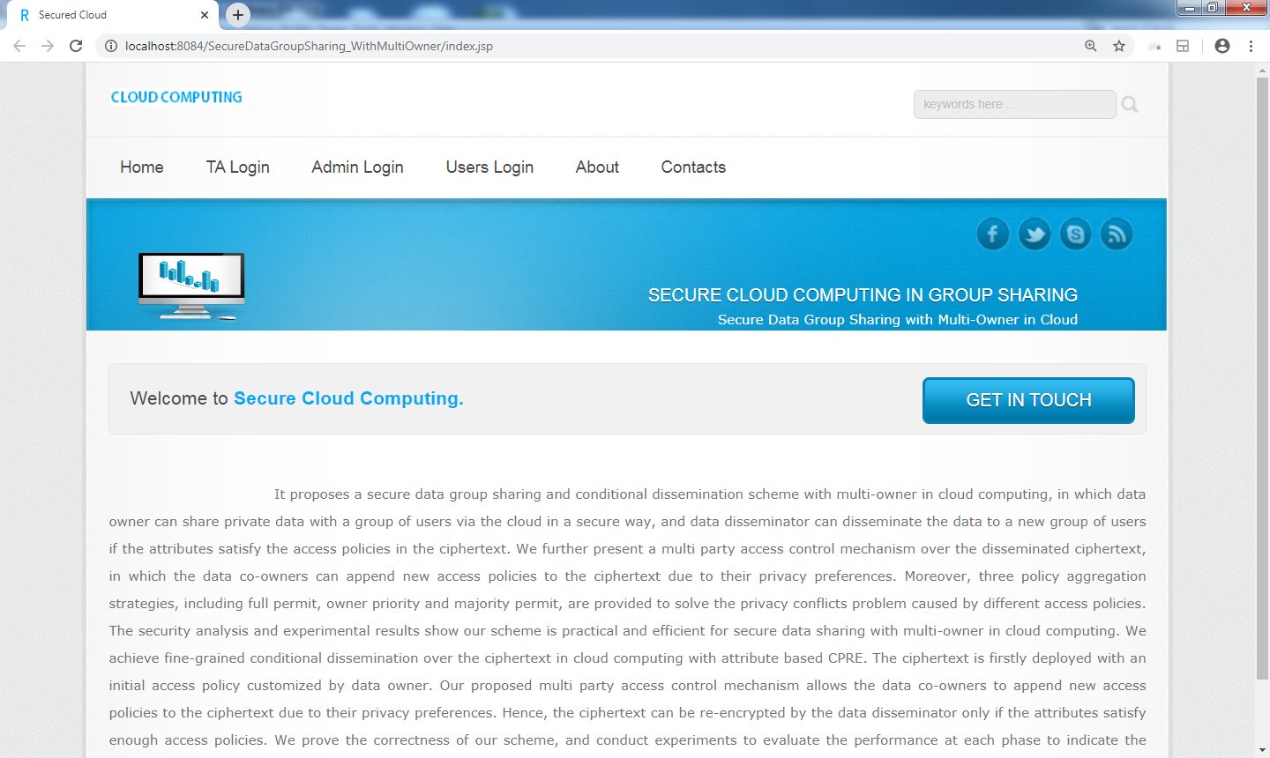
Home Page

Slide 28

Admin Login

Slide 29
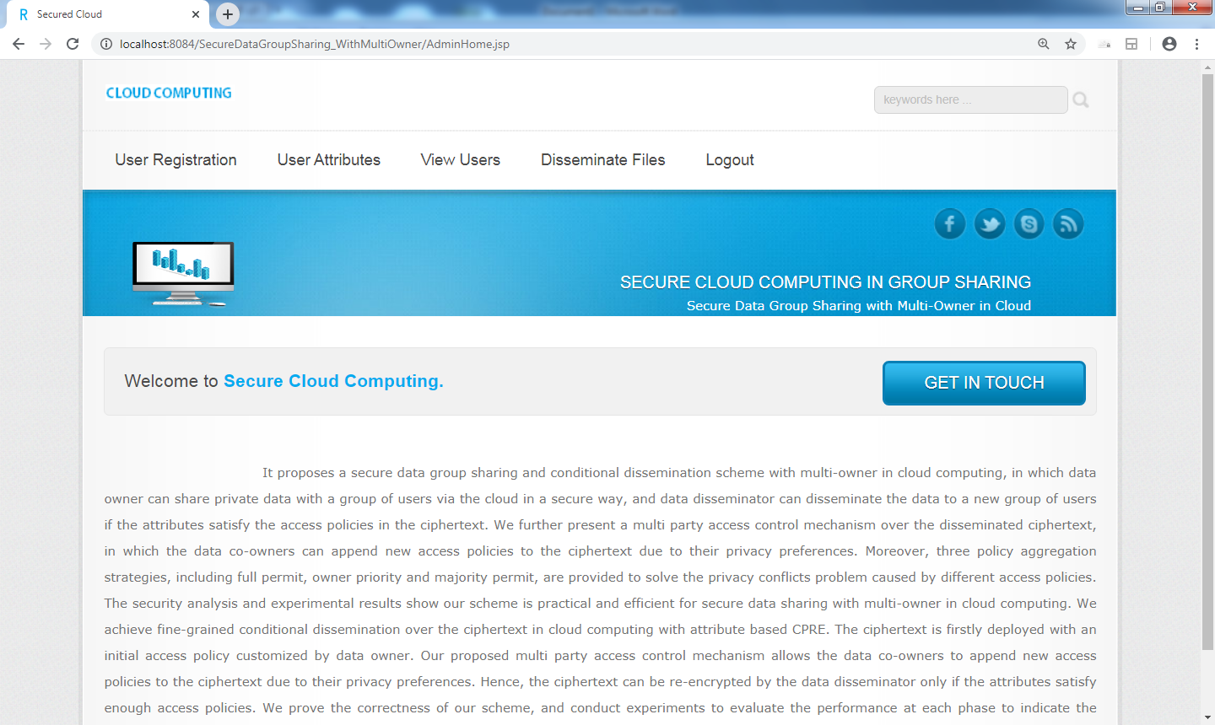
Admin Home

